Slide 1
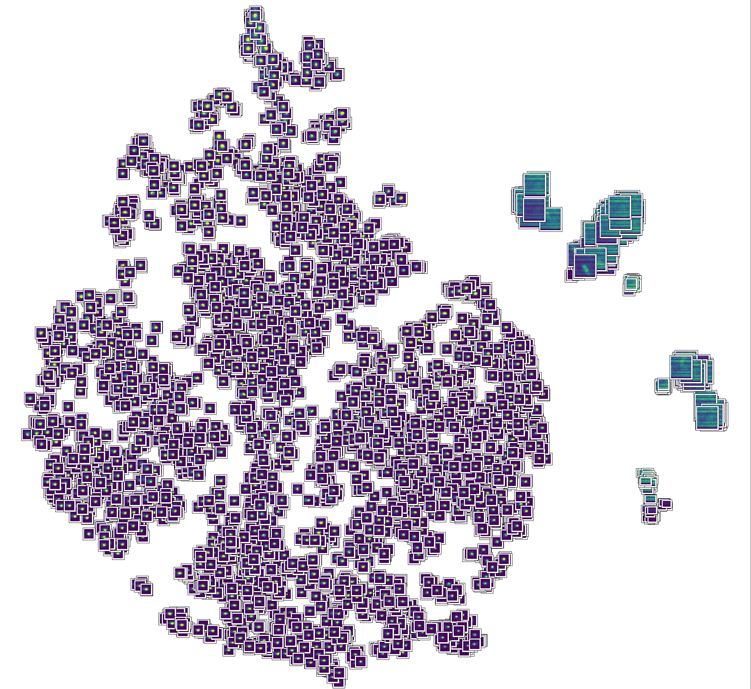
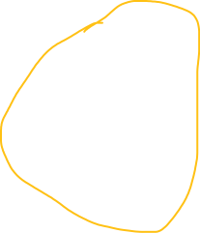

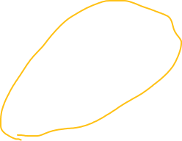

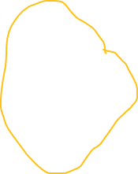
Large globby MPs
MPs with more apparent comet tails
MPs with more apparent comet tails
It’s not super clear to me whether the middle ones are significant. But it seems like as we go down and to the right, MPs get smaller and have more apparent tails
MPs without apparent comet tails

